Slide 1
Team Lab Results Report
Deepfake Audio Detection Models
Felipe Nobrega & Zheng Lin
University of Stuttgart

Slide 2
CNN with Wav2Vec v2 - Specifications
Input Features: Wav2Vec2 embeddings (768 dimensions) with a sequence length of 199 timeframes.
Convolutional Layers: Three 1D convolutional layers with ReLU activation and Batch Normalization:
Layer 1: 32 filters, kernel size 3, stride 1
Layer 2: 64 filters, kernel size 3, stride 1
Layer 3: 128 filters, kernel size 3, stride 1
Pooling: Max pooling layers (kernel size 2, stride 2) are applied after each convolutional layer to reduce dimensionality.
Fully Connected Layers:
First Layer: Linear layer with 256 neurons.
Second Layer: Linear layer with 64 neurons.
Output Layer: Linear layer with 1 neuron (sigmoid activation for binary classification).
Regularization: Dropout with a probability of 0.5 is applied after the convolutional layers and the first fully connected layer to prevent overfitting.
Activation Function: ReLU (Rectified Linear Unit) is used in the convolutional and fully connected layers.
Loss Function: Binary Cross-Entropy Loss.
Optimizer: Adam optimizer.
Rationale:
The CNN architecture is chosen for its ability to learn local patterns in the frequency domain of the audio signal. The Wav2Vec2 embeddings provide a rich, pre-trained representation of the audio, capturing both spectral and temporal information. The addition of Batch Normalization and Dropout enhances training stability and generalization performance. This model prioritizes explainability, allowing for visualization of feature importance using techniques like Grad-CAM.

Slide 3
CNN with Wav2Vec v2 - Results
Training Loop – Train/Val | Test Set – Final Results

Slide 5
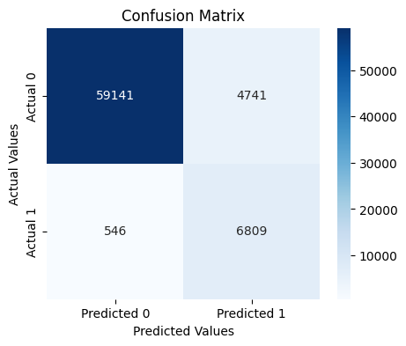
CNN with LFCC + Delta + Delta v5 - Results
Training Loop – Train/Val | Test Set – Final Results
Epoch [42/100] | Train Loss: 0.0405, Acc: 99.20% | Val Loss: 0.0152, Acc: 99.87% | Val EER: 0.27% | Evaluation Set: Loss: 0.9477 | Accuracy: 69.27% EER: 7.42% | Logit Threshold: 4.3701 | Prob Threshold: 0.9875 F1 Score: 0.7203 Precision: 0.5895 Recall: 0.9258 Predictions: [1]: 11550 | [0]: 59687

